Slide 1


TYRE CHANGER
INSTRUCTION & MAINTENANCE MANUAL
We follow the way that wheel moving!
Read this entire manual carefully and completely before installation or operation of the tire changer

Slide 2
.1211 . V201301
INDEX PAGE
1. Introduction: ...................................................................................................................................................................2
2. Safety Warnings:............................................................................................................................................................2
3. Technical data.................................................................................................................................................................3
4. Transport: .......................................................................................................................................................................3
5. Unpacking & Inspection:................................................................................................................................................3
6. Workplace requirements: ................................................................................................................................................3
7. Position and installation: ................................................................................................................................................4
8. Electricity and Pneumatic connections:..........................................................................................................................4
9. Adjusting operation: .......................................................................................................................................................4
9.1. Breaking the tyre bead：.....................................................................................................................................5
9.2. Demounting the tyre............................................................................................................................................5
9.3. Mounting the tyre ................................................................................................................................................5
10. Helping arm application: ..............................................................................................................................................6
10.1 098 Help Arm Components ................................................................................................................................6
10.2 098 Help Arm Operation ....................................................................................................................................6
11. Inflating the tire:........................................................................................................................................................7
12. Moving machine........................................................................................................................................................8
13. Maintenance: ................................................................................................................................................................8
14. Trouble shooting table:.................................................................................................................................................9
15. Exploded drawing: .....................................................................................................................................................10
16. Circuit diagram...........................................................................................................................................................19
17. Pneumatic drawing:....................................................................................................................................................19
- 1 –

Slide 3
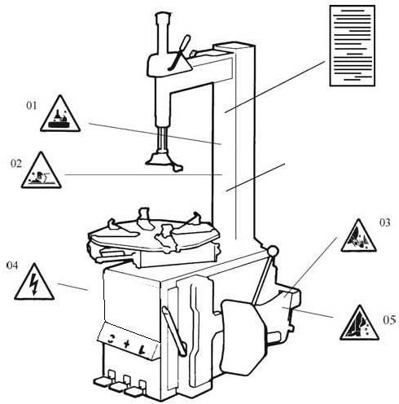

.1211 . V201301
Tyre Changer
Warning
This instruction manual is important for the machine, please read carefully before installation and use; also it is
important for safe use and machine maintenance of machine. Please keep this manual properly in order to further maintenance of the machine.
Introduction:
Application Range: The semi-automatic tyre changer is especially designed for demounting / mounting tyres from wheel rims.
Caution：Please use the machine only for purpose for which it is designed, don't use it for other purposes.
Manufacturer shall not be liable for any damage or injury caused by failure to comply with these regulations.
Safety regulation: Use of this machine is especially reserved to trained and qualified professional persons, those who already read the introduction manual carefully, or someone have the experience for operating similar machinery. Any changes and beyond the scope of use on this machine without manufacturer’s permission or do not according to the manual, may cause the malfunction and damage to machine, manufacturer can cancel warranty coverage for above. If some parts are damaged due to some reason, please replace them according to the spare parts list. (Attention: warranty is one year after manufactures’ delivery date; warranty excludes the easy-broken parts).
Safety Warnings:
01 Don’t put hands under the Mounting/demounting head during operation; 02 Don’t put hands between the jaws during operation;
Don’t put hands inside the tyre bead when demounting the tyre;
Make sure and to check the system is equipped with a good grounding circuit; 05 Don’t put feet between the Bead Breaker shovel and the body during operation;
Security warning labels
Caution:
When the security warning labels are defaced or off, please recovery them in time!
Do not allow to operate when the security warning labels are missed or imperfect. Do not allow to set any objects to obscure the security warning labels.
Clients can self-set the warning labels (as right picture show) at any necessary positions.
- 2 -

Slide 4
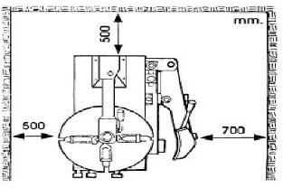
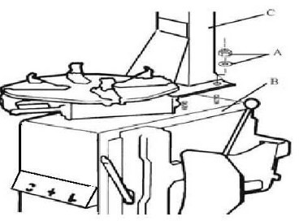
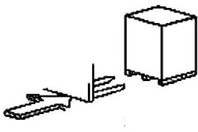
.1211 . V201301
3. Technical data
External locking rim dimensions | 10~21＂
Internal locking rim dimensions | 12~24＂
Max. Wheel diameter | 1040mm(41＂)
Max. Wheel width | 355mm(14＂)
Working Pressure | 8-10bar
Power supply | 110V (1ph)/ 220V (1ph)/ 380V (3ph)
Optional Motor power | 0.75/0.55/1.1 kw
Max. Rotating Torque (Turntable) | 1078 Nm
Overall Dimension | 96*76*93cm
Noise Level | 75 Db
Remark:
Rim dimensions defined at above table are based on the iron wheel rims. Aluminum rims are thicker than the iron wheel rims, so here above rim dimensions are just for the reference.
Here above machine versions can be equipped with Rapid Tire Inflation Device (client optional device), IT-suffix version, accessory details can be found at the IT-suffix version exploded drawing.
Transport:
When transporting, the machine should be with original package and placed according to the mark on the package. For the already packaged machine should be handled with a corresponding tonnage forklift for loading and unloading. The location to insert the fork feet shown as Fig 1
Unpacking & Inspection:
Pull out the nail which is nailed on the plate with tip jaw; unpack the carton and plastic cover. Check and make sure all parts shown on the spare parts list are included. If any parts are missing or broken, please do not use the machine and contact the manufacturer or dealer ASAP.
Fig 1
6. Workplace requirements:
Fig 2
Fig 3
Choose workplace in compliance with safety regulations. Connect power supply and air source according to manual and workplace must have good air condition; in order to make the machine run well, its workplace requires at least clear space from each wall shown as Fig 2. If installing it outdoor, it must be protected by roof against rain and sunshine.
Warning: the machine with motor must not be operated in explosive atmosphere.
- 3 –

Slide 5
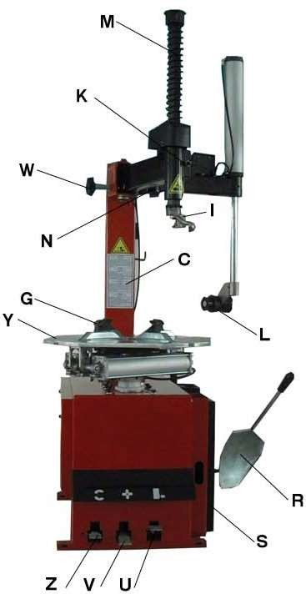



.1211 . V201301
Position and installation:
  Unscrew the nuts at the bottom, position the machine and calibrate it with the horizontal rule. Mount the machine with all the screws and to ensure the machine is stable. Make sure the system is equipped with a good grounding circuit for prevent electric leakage. And have operation range of ground for skid prevention.
  Unscrew the nut A on the cabinet body B as shown in Fig 3.
Lift the column C; mount it on the machine body B by using the nut A through the bolt located on the machine body B. If the column becomes loose after a period of
using, tight them immediately. Otherwise the result of damage to the tyre may happen.
Electricity and Pneumatic connections:
Caution: Before installation and connection, check to be sure that the electricity power supply corresponds to the machine technical data. All the installation of electric and pneumatic devices must be operated by a professional electrician.
Connect the compressed air connector which is on the machine right side with compressed air system. The electric grid that the machine connects to must have fuses protection device and good outer cover grounding protection. Install the leakage automatic air switch on the maim power supply, leakage current is set at 30A
Fig 4
Caution: No power plug for this machine, the user should self-connect one power plug no less than 16A as well as in line with the machine voltage. Or directly connect with the power supply according to the above requirements.
9. Adjusting operation:
Turntable Rotation Pedal (Z)
Bead Breaker Pedal (U)
Jaws open and close Pedal (V)
Tread the Turntable Rotation Pedal (Z), Turntable (Y) clockwise rotation; Lift up the Turntable Rotation Pedal (Z), Turntable (Y) counterclockwise rotation.
Tread Bead Breaker Pedal (U), Bead Breaker shovel (R) close toward inside; release Bead Breaker Pedal (U), Bead Breaker shovel (R) return to original position.
Tread Jaws open and close Pedal (V), four clamps (G) on the turntable open; tread again, four clamps (G) close. When the pedal is in the middle position, the four clamps stop moving.
Tyre changer operation is consisted of three parts:
1）Breaking the tyre bead 2） Demounting the tyre 3）Mounting the tyre
Caution: Before any operations, don’t wear loose clothing and wear protective hat, gloves, and skid-proof shoes. Ensure to exhaust the air in the tyre completely, and remove all the wheel weights from the rim.
- 4 -

Slide 6
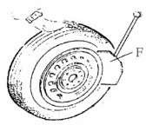
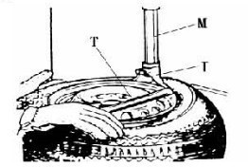
9.1. Breaking the tyre bead：
Ensure to exhaust the air in the tyre completely, place the tyre against the rubber buffer (S). Bring the paddle against the bead about 10mm from the edge of the rim shown as Fig 5. Tread Bead breaker Pedal (U) to push paddle into tyre. Repeat the above operations on different positions around the tyre and both sides of tyre until tyre bead is released completely.
.1211 . V201301
9.2. Demounting the tyre :
Fig 5
Ensure to remove all the weights on the wheel rim and to exhaust the air in the tyre completely before this operation. Apply lubricating grease (or similar lubricant) around the tyre bead. Without the lubricant may lead to badly wear and tear on tyre.
Clamp the wheel methods shown as below regarded to the ruled dimension:
to clamp the wheel from outside:
Tread the Jaws open and close Pedal (V) halfway down to middle, positioning for the four clamps (G) by reference scale on the Turntable (Y); put the tyre on turntable, hold the rim, and tread the Jaws open and close Pedal (V) until
the wheel is secured by the jaws.
to clamp the wheel from inside:
Positioning for the four clamps (G) and let them all closed. Put the tyre on the turntable and tread the Jaws open and close Pedal (V) to open the clamps thereby lock the wheel in place.
Caution: Check to make sure the wheel firmly secured by the four clamps before next step.
Lower the Vertical Arm (M) until the Mounting/demounting head (I) rests next to the edge of the rim, flip the Locking Handle to lock the Vertical Arm and Swing Arm in position, and also adjust the Rocker Arm make Mounting/demounting head can raise 2mm-3mm automatically from the edge of the wheel rim. Insert the Lifting Lever (T) between the tyre bead and the front section of the mounting/demounting head (I), and move the tyre above the mounting/demounting head as shown as Fig 6.
Caution: Chains, bracelets, loose clothes and anything else close to the rotating parts w^{F}il^{i}l^{g}b⁶ring danger to the operator.
With the Lifting Lever held in position, tread the Turntable Rotation Pedal (Z), rotate the Turntable (Y) in a clockwise direction until the tyre is completely separated from the wheel rim.
For the other side tyre demounting, keep using the lifting lever to lift the tyre, make the other side tyre separated from the wheel rim.
9.3. Mounting the tyre :
Caution: Check to make sure that the tyre and the wheel rim are of same size before mounting the tyre.
To avoid any damage on type, lubricate the tyre bead and the wheel rim with the lubrication recommended by manufacturer. Put on the tyre and check the situation.
Caution: When clamp the wheel rim, don't put your hands on the wheel rim to avoid injury during this operation.
- 5 –

Slide 7
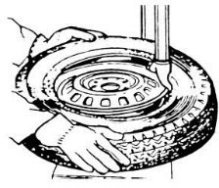
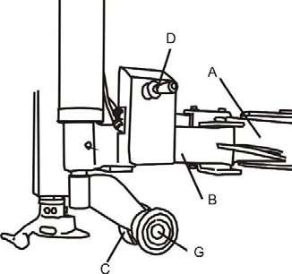
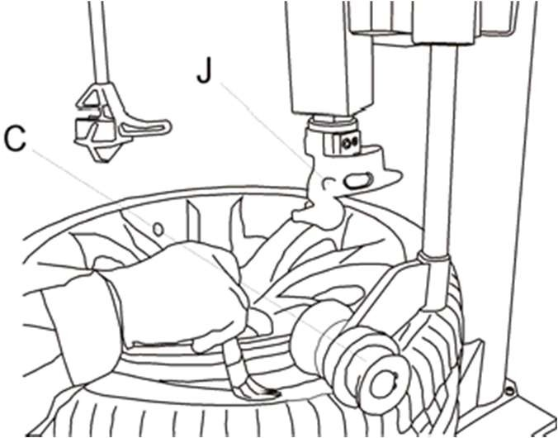









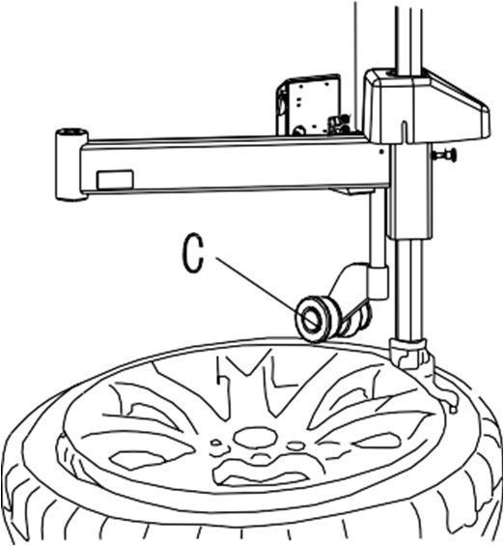
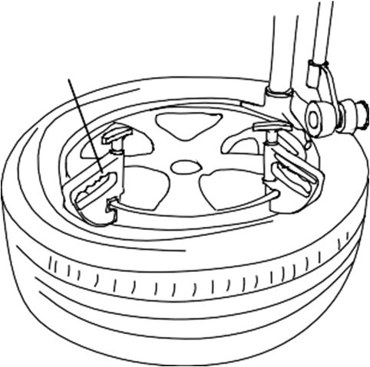
.1211 . V201301
Lock the Hexagonal Vertical Mounting Arm, put the tyre on the rim, let the Rocker Arm back to place as demounting the tyre. And let one side of tyre down bead above the rear section of the Mounting/demounting head, the other side under the front section of the Mounting/demounting head. Suppress the trye with hands or help arm, and then spin the turntable for mounting the tyre down bead.
Repeat the above operation for mounting the tyre up bead. (Fig 7)
Fig 7
10. Helping arm application:
F
Fig 8
Fig 9 Fig 10
Helping arm at right side is auxiliary device of tyre changer for helping operator to demount and mount tyre.
10.1 098 Help Arm Components
Each components of helping arm device are introduced as follows:
A- Swing arm C- Roller C
B- Small helping arm
D- Raise-fall roller handle
F- Locking switch for right helping arm
G- Roller G
The function of helping arm control handle is as follows:
Roller lifting handle (D, Fig 8) is for lifting and lowering roller C、G so as to adjust tyre demounting / mounting vertical height. Operate handle (D, Fig 8 ) up, then roller C、G goes up；Operate handle (D, Fig 8 )down，then roller C、G goes down.
Fig 11
10.2 098 Help Arm Operation
It is difficult to demount and mount big and flat profile tyre. If operation is proper, it is very easy to use helping arm device to demount and mount tyre from rim. The helping arm device may also be used
when demounting and mounting normal tyre with resistance.
1
a. Clamp rim
Firstly, press both side tyre loose as per operation instruction in user’s manual. Force of demounting and mounting is big when helping arm device is used. And rim may be
damaged easily. It is recommended that to clamp rim from outsid（e jaw protector may be installed on jaws）. Tread relevant pedal to make jaws open to clamp edge of rim, move
helping arm’s rotary arm to far-end. Put on tyre, tread relevant pedal to make jaws close and to approach rim
Fig 12
- 6 -

Slide 8
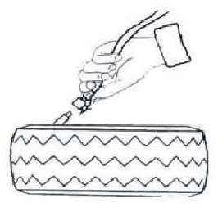
.1211 . V201301
b. Demount tyre
Press tyre with right pressing roller C,G to a position 3cm lower than rim edge, lubricate tyre bead, rotate turntable, lift roller C,G. ( Fig 9 )
Move demounting/mounting head close to edge of rim, keep a 2-3mm gap between demounting/mounting head and rim plane，operate locking handle（K，Fig 4）to lock vertical arm，adjust screw bolt in column to position swing arm, make sure 2-3mm gap between demounting/mounting head and rim edge side
Nearby demounting/mounting head, insert lift lever N into tyre，use lift lever to lift bead upon knob of
demounting / mounting head. Manually rotate roller C to inner side，pull handle D down, make roller C to press rim， keep 3-5mm gap between demounting/mounting head and rim, make sure demounting/mounting head not damage
rim, rotate turntable, demount tyre upper bead ( Fig 11)
Push handle D up，lift roller C,G，press switch F，loosen right pressing arm,
Lift tyre up, insert lifting level into bottom tyre bead nearby demounting/mounting head, lift bead upon knob of demounting / mounting head and rotate turntable to demount down tyre bead
c. Mount tyre
Lubricate tyre and rim edge with lubricant to avoid damage of tyre. Adjust height of demounting/mounting head and make tyre bottom bead upon rear of demounting/mounting head and below front of demounting/mounting head.
Rotate turntable to mount bottom bead.
Make tyre top bead upon rear of demounting/mounting head and below front of emounting/mounting head, move right pressing arm and make sure it is locked, pull handle D down to make roller C,G to press top bead to position
below demounting/mounting head. Lock pressing block 1 on rim edge, rotate turntable, finish tyre mounting. (Fig 12)
Inflating the tire:
Importance: It is very dangerous during inflating operation, take carefully and comply with instruction. When inflating, it will turn to be extremely dangerous if problems happen to tyre or rim. The possible burst force tire goes upward and outward, the big power may cause injury or death of the operator or the people around.
Tyre may burst caused by following:
  The wheel rim and the tyre are not of the same size;
  The tyre or the wheel rim is damaged;
  The pressure of tyre inflation is over the max. pressure recommended by manufacturer;
  The operator fail to comply with the safety regulation;
Fig 13
Please operate as follows:
Remove the valve cap from the valve stem;
Check to make sure the air nozzle is pressed down completely over the threads of the valve stem.
Check to make sure that the tyre and the wheel rim are of the same size;
Lubricate both the tyre bead and the wheel rim, additional lubrication is required if needed;
Inflate the tyre with break, while inflating, check the pressure listed on the pressure gauge, also check whether the bead is fixed or not. Repeat operation above until the bead is secured; you need take special steps when inflating convex rim or double convex rim;
Continue inflating and check the air pressure frequently until to reach the required pressure.
Note:
Never exceed the max. inflation pressure given by the tyre manufacturer. Keep hands and your body away from inflating tyres.
Only specially trained persons are allowed to perform the operations, do not allow other to operate or be near the tyre changer.
- 7 –

Slide 9
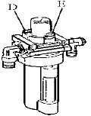
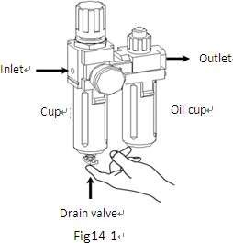
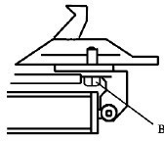
.1211 . V201301
Moving machine:
Please use forklift to move the machine. Disconnect the tyre changer from the electricity power supply and pneumatic power supply, lift the base board and insert the feet of forklift. Then mount the tyre changer machine to a new position and fix it tightly.
Note: the place chosen for fixing the tyre changer must meet the safety regulation.
Maintenance:
Caution: only the professional persons can do the maintenance. To prolong the machine's life, maintain the machine timely according to the manual. Otherwise, it will impact the reliability of the machine or even cause injury to operator and others nearby.
Caution: before performing any maintenance, disconnect the tyre changer from the electric power supply and pneumatic power supply, and tread the Jaws open and close Pedal or Turntable Rotation Pedal for 3~4 times to evacuate all compressed air from the machine. Damaged parts must be replaced by professional persons with the spare parts provided by manufacturer.
Clean the machine once every day after work. Clean the dirt on the turntable with diesel oil once per week and lubricate the slides and clamps.
Following maintenance must be done at least once per month:
Check oil level in Oil Fog Maker, please be filled with SAE30# oil if need. Unscrew with hex wrench (E). Based on connection of compressed air, first to
tread Jaws open and close Pedal or Turntable Rotation Pedal 5-6 times, and then check whether oil in Oil Fog Maker drops down a drip of oil. For continuous operation, tread twice every time, drop down a drip of oil, otherwise adjust the screw (D) that controlled oil enter with minus screwdriver.
(Fig 14)
Fig 14
- As shown in Figure 14-1, when you found there are some water in the cup, push up
the drain valve to drain away water with your fingers; loosen your fingers after drained water, drain valve can be automatic closed under the action of the spring.
Note: After the first 20 days of use, retighten the jaws with tightening screws (B) on the Turntable (Fig 15)
Note: in the event of turntable lose power, check to see if the belt is tight as follow steps: Remove the left side cover by unscrewing the screws; adjust two screws located on the motor support, keep a suitable distance between motor support and motor base; tight the screws for the belt tension.(Fig 16)
Fig 15
Caution: please disconnect the machine from electric power supply and pneumatic power supply.
Note: If Hexagonal Vertical Arm not be locked or not meet the requirement that 2-3mm from the bottom of Mounting/demounting head to rim, please adjust Hexagonal Locking Plate, refer to Fig 17 and adjust the (X).
- 8 -

Slide 10
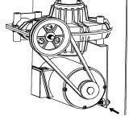
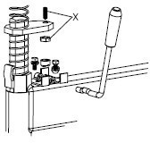
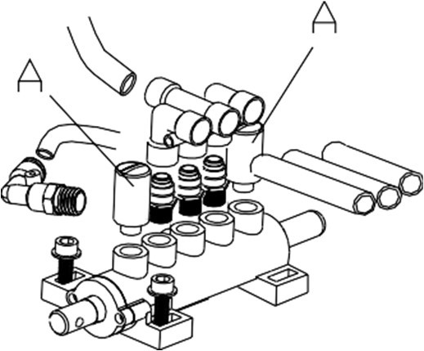
.1211 . V201301
Note: In order to achieve the reliability of jaws and Bead Breaker shovel, operate as follows to keep their valves clean:
Remove the left side cover of the machine body by unscrewing the two screws;
Loosen the valve Muffler (A) which belong to Jaws open and close Pedal and Bead Breaker Pedal; (Fig 18)
Clean the mufflers with compressed air, please replace it referring to the spare parts list if it is damaged. (Fig 18)
Fig 18
Fig 16
Fig 17
14. Trouble shooting table:
Problem | Reason | Solution
The turntable rotate just in one direction or can’t rotate. | Reverse Switch broken | Replace the Reverse Switch
 | Belt broken | Replace the belt
 | The Motor’s malfunction | Check the motor cable or terminal block wire; Replace the motor if it was broken.
Demount or fix the wheel, the turntable can’t lock (spin with wheel); The jaws delay to open/close; The turntable locks the rim incorrectly. | Leakage of Air network | Check all the parts on the air network.
 | The clamping cylinder can’t work. | Replace the cylinder piston.
 | Worn jaws | Replace the jaws.
 | Broken washers of the chuck cylinder | Replace it.
The mounting/demounting head always touch the rim during operation. | The locking plate incorrectly adjust or unqualified. | Replace or adjust it.
 | Screws on the chuck loose; the Hexagonal Vertical Arm can’t be locked by Locking Plate | Tighten the screws; replace the Locking Plate.
The Bead Breaker Pedal and Jaw open and close Pedal can’t turn back to the original position. | Pedal spring broken | Replace it.
The Bead Breaker shovel operates difficultly. | Jammed silencer | Clean it or replace it.
 | The washer on the Bead Breaker cylinder is broken. | Replace it.
- 9 –

Slide 11
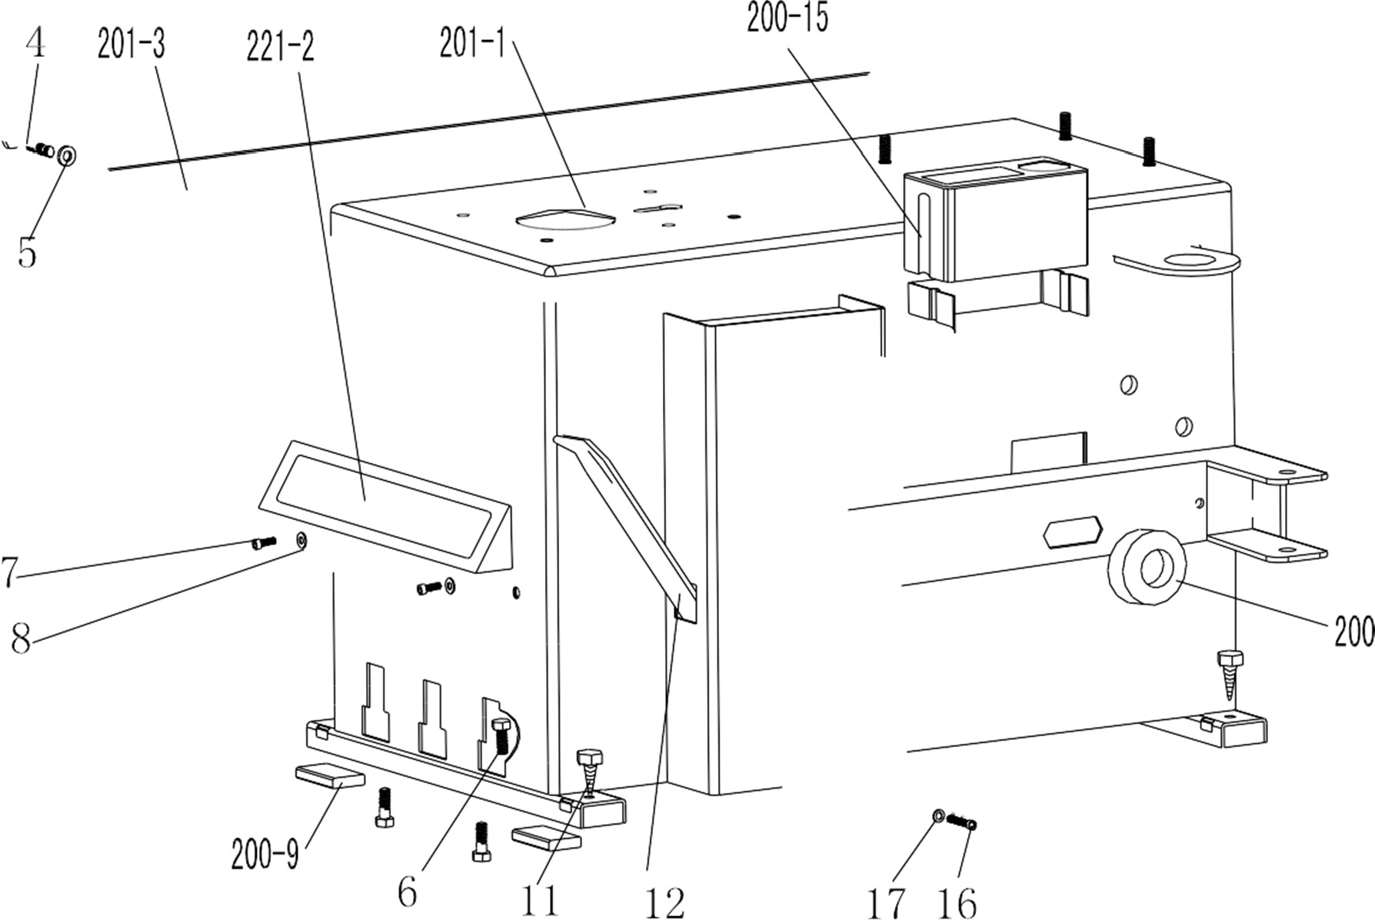

.1211 . V201301
15. Exploded drawing:
201-1 | CX-201-010000-0 | Machine body
221-2 | CZ-221-080000-0 | Pedal front cover
201-3 | CX-201-020000-0 | Left cover
4 | B-010-060101-0 | Hex socket head bolt M6×10
5 | B-040-061412-1 | Flat washer Ø6*14*1.2
6 | B-014-080251-0 | Outer hex bolt M8x25
7 | B-010-080201-0 | Hex socket head bolt M8×20
8 | B-040-061412-1 | Flat washer Ø 6*14*1.2
200-9 | C-000-001020-0 | Rubber foot buffer
200-10 | C-200-500000-0 | Bead breaker buffer
11 | B-027-060401-0 | Grounding screw M6x40
12 | C-200-580000-0 | Lifting lever
200-14 | C-200-510000-0 | Bead breaker arm rubber
200-15 | C-200-470000-0 | Oil-water box
16 | B-010-080201-0 | Hex socket head bolt M8x20
17 | B-040-081715-1 | Flat washer Ø 8*17*1.5
- 10 -

Slide 12
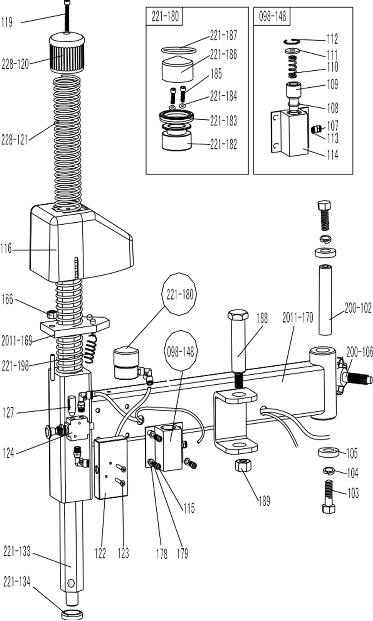
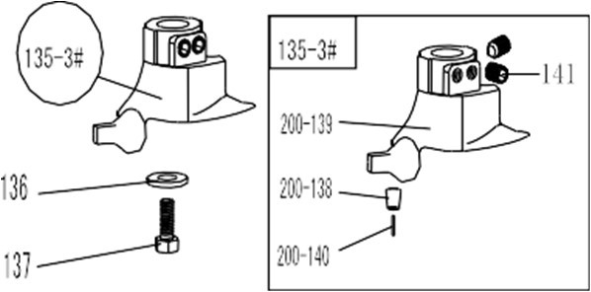




.1211 . V201301
2011-101 | CX-2011-250000-0 | Square column
200-102 | CX-200-190000-0 | Swing arm pin
103 | B-014-140351-0 | Outer hex bolt M14x35
104 | B-050-140000-0 | Spring washer Ø14
105 | CX-200-140000-0 | Big washer
200-106 | C-200-350000-0 | Column adjust handle
107 | S-010-050004-0 | Quick straight union M5- Ø 4
108 | S-000-030355-0 | O-seal 30X3.55
109 | CX-007-180600-0 | 098 Swing arm spring plate
110 | C-007-180700-0 | 098 Swing arm spring
111 | CX-007-180800-0 | 098 Swing arm plate washer
112 | B-055-300002-0 | Snap ring Ø30(hole)
113 | S-000-005200-0 | O-seal Ø 5.6X2
114 | CX-098-080000-0 | 098 Pneumatic lock barrel
115 | B-010-060201-0 | Hex socket head bolt M6X20
116 | C-298-480000-0 | Locking plate cap
119 | B-010-100301-0 | Hex socket head bolt M10×30
228-120 | C-228-490000-0 | Vertical arm cap
228-121 | C-228-390000-0 | Vertical arm spring
122 | C-098-090000-0 | Locking switch box
123 | B-017-040301-0 | cross head screw M4*30
124 | S-030-010414-2 | Hand valve
127 | S-023-010801-0 | Muffler 1/8"
221-133 | CX-221-160000-0 | Vertical arm
221-134 | C-228-520000-0 | Vertical arm washer
135-3# | CW-113-020003-0 | Complete mount/demount head 3#
200-138 | CX-200-150200-0 | Mount/demount head pulley
200-139 | C-200-150100-3 | Mount/demount head 3#
200-140 | C-200-150400-0 | Hex round pin
141 | B-007-120161-0 | Hex socket head bolt M12X16
136 | CX-200-170000-0 | Mount/demount head flat washer
137 | B-014-100251-0 | Outer hex bolt M10×25
098-148 |  | Complete 098 Pneumatic lock
166 | B-001-100001-0 | Self-locking nut M10
2011-169 | CX-298-22000-0 | Hex locking board 2011
2011-170 | CX-211-180000-0 | Swing arm 2011
178 | B-040-061210-1 | Flat washer Ø6
179 | B-050-060000-0 | Spring washer Ø6
221-180 |  | Complete locking cylinder
221-182 | C-221-090100-0 | locking cylinder piston
221-183 | S-005-050065-1 | V- seal 50*60*6.5
221-184 | S-000-005200-0 | O- seal Ø 5.6*2
185 | B-010-060551-0 | Hex socket head bolt M6×55
221-186 | CX-221-090200-0 | locking cylinder cover Ø 60
221-187 | S-000-052200-0 | O- seal Ø52*2
188 | CX-098-030000-0 | Pressing arm pin (right)
189 | B-001-160001-1 | Self-locking nut M16*1.5
221-198 | C-221-400000-0 | Hex locking board spring
- 11 –

Slide 13
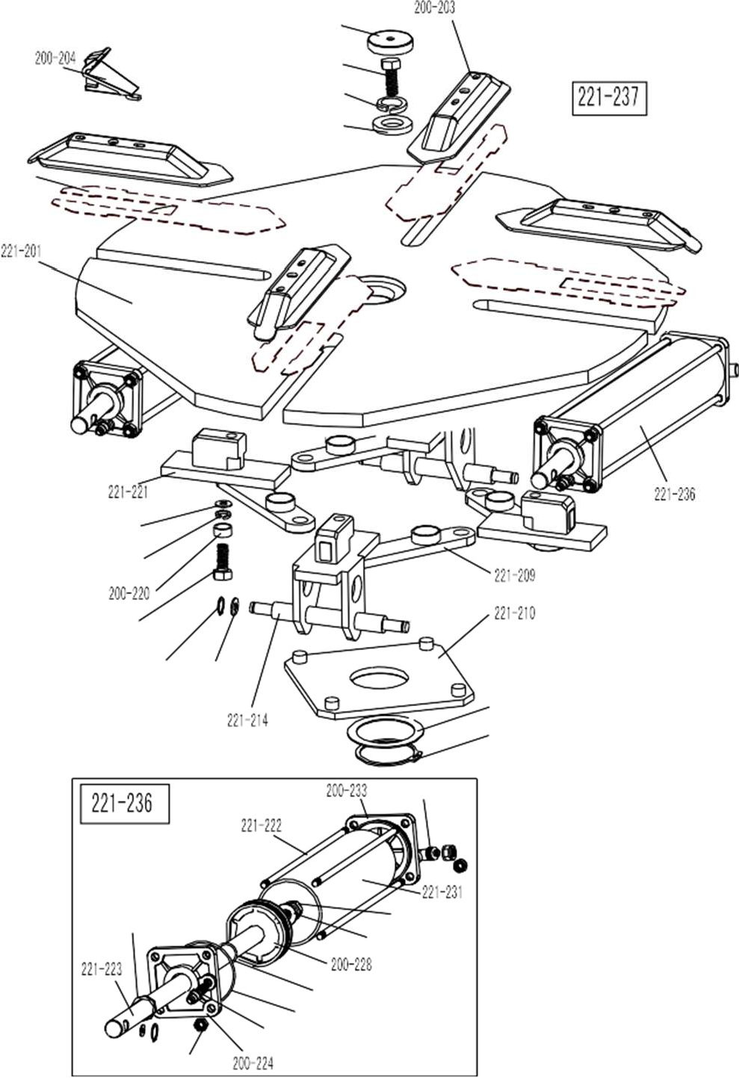




.1211 . V201301
208
207
206
205
221-201 | CX-221-130000-0 | Turntable assembly 615
202 | CX-221-120300-0 | Jaw sliding plate(optional)
200-203 | CX-200-120000-0 | Jaw cap assembly
200-204 | C-200-570000-0 | Jaw 200
205 | CX-200-140000-0 | Big washer
206 | B-050-160000-0 | Spring washer Ø16
207 | B-014-160401-0 | Outer hex boltM16×40
208 | C-200-440000-0 | Turntable cap
221-209 | CX-221-310000-0 | Connection rod assembly 615
221-210 | CX-221-280000-0 | Square turntable 615
211 | CX-200-290000-0 | Square turntable washer
212 | B-055-650001-0 | Snap ring Ø65(shaft)
221-214 | CX-221-110000-0 | Jaw slide guide with pin
215 | B-040-122520-1 | Flat washer Ø12X25X2
216 | B-055-120001-0 | Snap ring Ø12(shaft)
217 | B-014-120801-0 | Hex socket head boltM12×40
218 | B-046-122050-1 | Teeth locking washer Ø12x20.5x1
221-237 | CW-104-021100-0 | Complete square turntable 615
219 | B-040-123030-1 | Flat washer Ø12X30X3
200-220 | CX-200-300000-0 | Connection rod nut
221-221 | CX-221-110100-0 | Jaw slide guide without pin
221-222 | C-221-100400-0 | Threaded connection rod 393
221-223 | C-221-100200-0 | Clamping cylinder piston rod 400
200-224 | C-200-100100-0 | Clamping cylinder cover without handle
225 | S-011-010808-0 | Straight union 1/8"-Ø8
226 | S-005-020075-0 | V- seal 20*28*7.5
227 | S-000-063265-0 | O- seal 63*2.65
200-228 | C-200-540000-0 | Clamping cylinder piston Ø70
229 | B-040-122520-1 | Flat washer Ø12X25X2
230 | B-004-120071-1 | Nut M12X7X1.75
221-231 | C-221-100500-0 | Clamping cylinder barrel 360
232 | S-000-019262-0 | O- seal Ø19.6X2.62
200-233 | C-200-100300-0 | Clamping cylinder cover with handle
234 | S-018-010808-0 | Union 1/8-Ø8
235 | B-001-080001-0 | Self-locking nut M8
221-236 | CW-105-021101-0 | Complete clamping cylinder
202
219
218
217
216 215
211
212
234
226
230
229
232
227
225
235
- 12 -

Slide 14
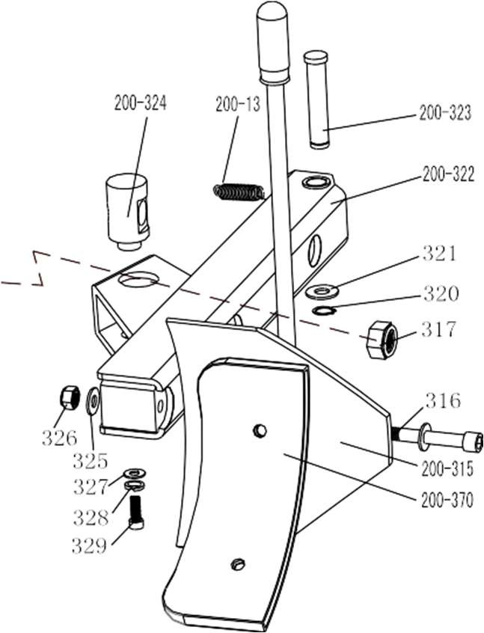
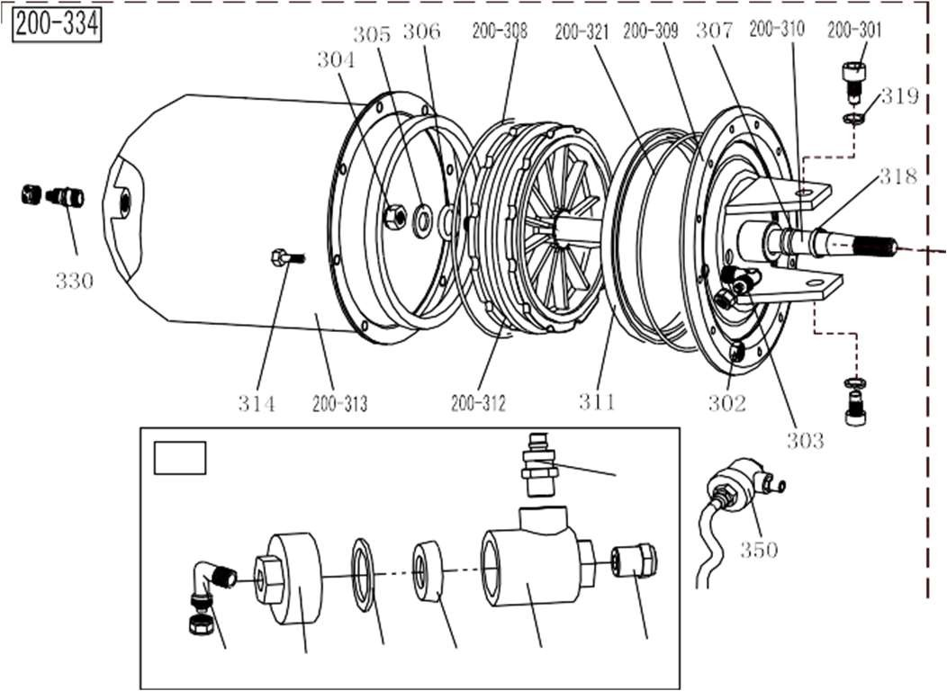

.1211 . V201301
200-13 | C-200-360000-0 | Bead breaker arm spring | 320 | B-055-160001-0 | Snap ring Ø16
200-301 | B-010-140301-0 | Hex socket head boltM14×30 | 321 | B-040-162820-1 | Flat washer
302 | B-001-060001-0 | Self-locking nut M6 | 200-321 | S-000-175500-0 | O-seal Ø173.4x5.3
303 | S-018-010408-0 | Union (90°) 1/4-Ø8 | 200-322 | CX-200-030000-0 | Bead breaker arm 200
304 | B-001-160001-1 | Nut M16*1.5 | 200-323 | CX-200-040000-0 | Bead breaker pin
305 | B-040-162820-1 | Flat washer Ø16*28*2 | 200-324 | CX-200-050600-0 | Bead breaker cylinder rotating pin
306 | S-000-016265-0 | O-seal Ø 16*2.65 | 325 | B-040-122520-1 | Flat washer Ø12*24*2
307 | S-000-020265-0 | O-seal Ø 20*2.65 | 326 | B-001-120001-0 | Self-locking nut M12
200-308 | S-000-180500-0 | O-seal 180x5 | 327 | B-040-083030-1 | Flat washer Ø8*30*3
200-309 | CX-200-050500-0 | Bead breaker cylinder cover assembly | 328 | B-050-080000-0 | Spring washer Ø8
200-310 | C-200-050100-0 | Bead breaker cylinder piston rod | 329 | B-014-080201-0 | Outer hex bolt M8×20
311 | S-005-168115-0 | V-seal 185X168X11.5 | 330 | S-011-010808-0 | Straight union1/8-Ø8
200-312 | C-200-050200-0 | Bead breaker cylinder piston | 200-334 | CW-108-020000-0 | Complete Bead breaker cylinder
200-313 | CX-200-050300-0 | Bead breaker cylinder barrel | 350 | CW-112-209800-0 | Bead breaker cylinder exhaust valve
314 | B-010-060161-0 | Hex socket head bolt M6×16 | 351 | S-012-010808-0 | Union (90°)1/8-Ø8
200-315 | CX-200-070000-0 | Bead breaker shovel assembly | 352 | C-098-600200-0 | Bead breaker cylinder exhaust valve cover
316 | B-010-120901-0 | Hex socket head bolt M12×90 | 353 | C-098-600400-0 | Seal washer
317 | B-001-160001-1 | Self-locking nut M16*1.5 | 354 | C-098-600300-0 | Bidirectional seal
318 | U-006-000001-2 | Guide belt | 355 | C-098-600100-0 | Bead breaker cylinder exhaust valve barrel
200-370 | C-200-070600-0 | Bead breaker shovel protection cover(optional) | 356 | S-023-010401-6 | Muffler
319 | B-050-140000-0 | Spring washer Ø14 | 357 | S-010-010408-0 | Straight union1/8-Ø8
- 13 –

Slide 15
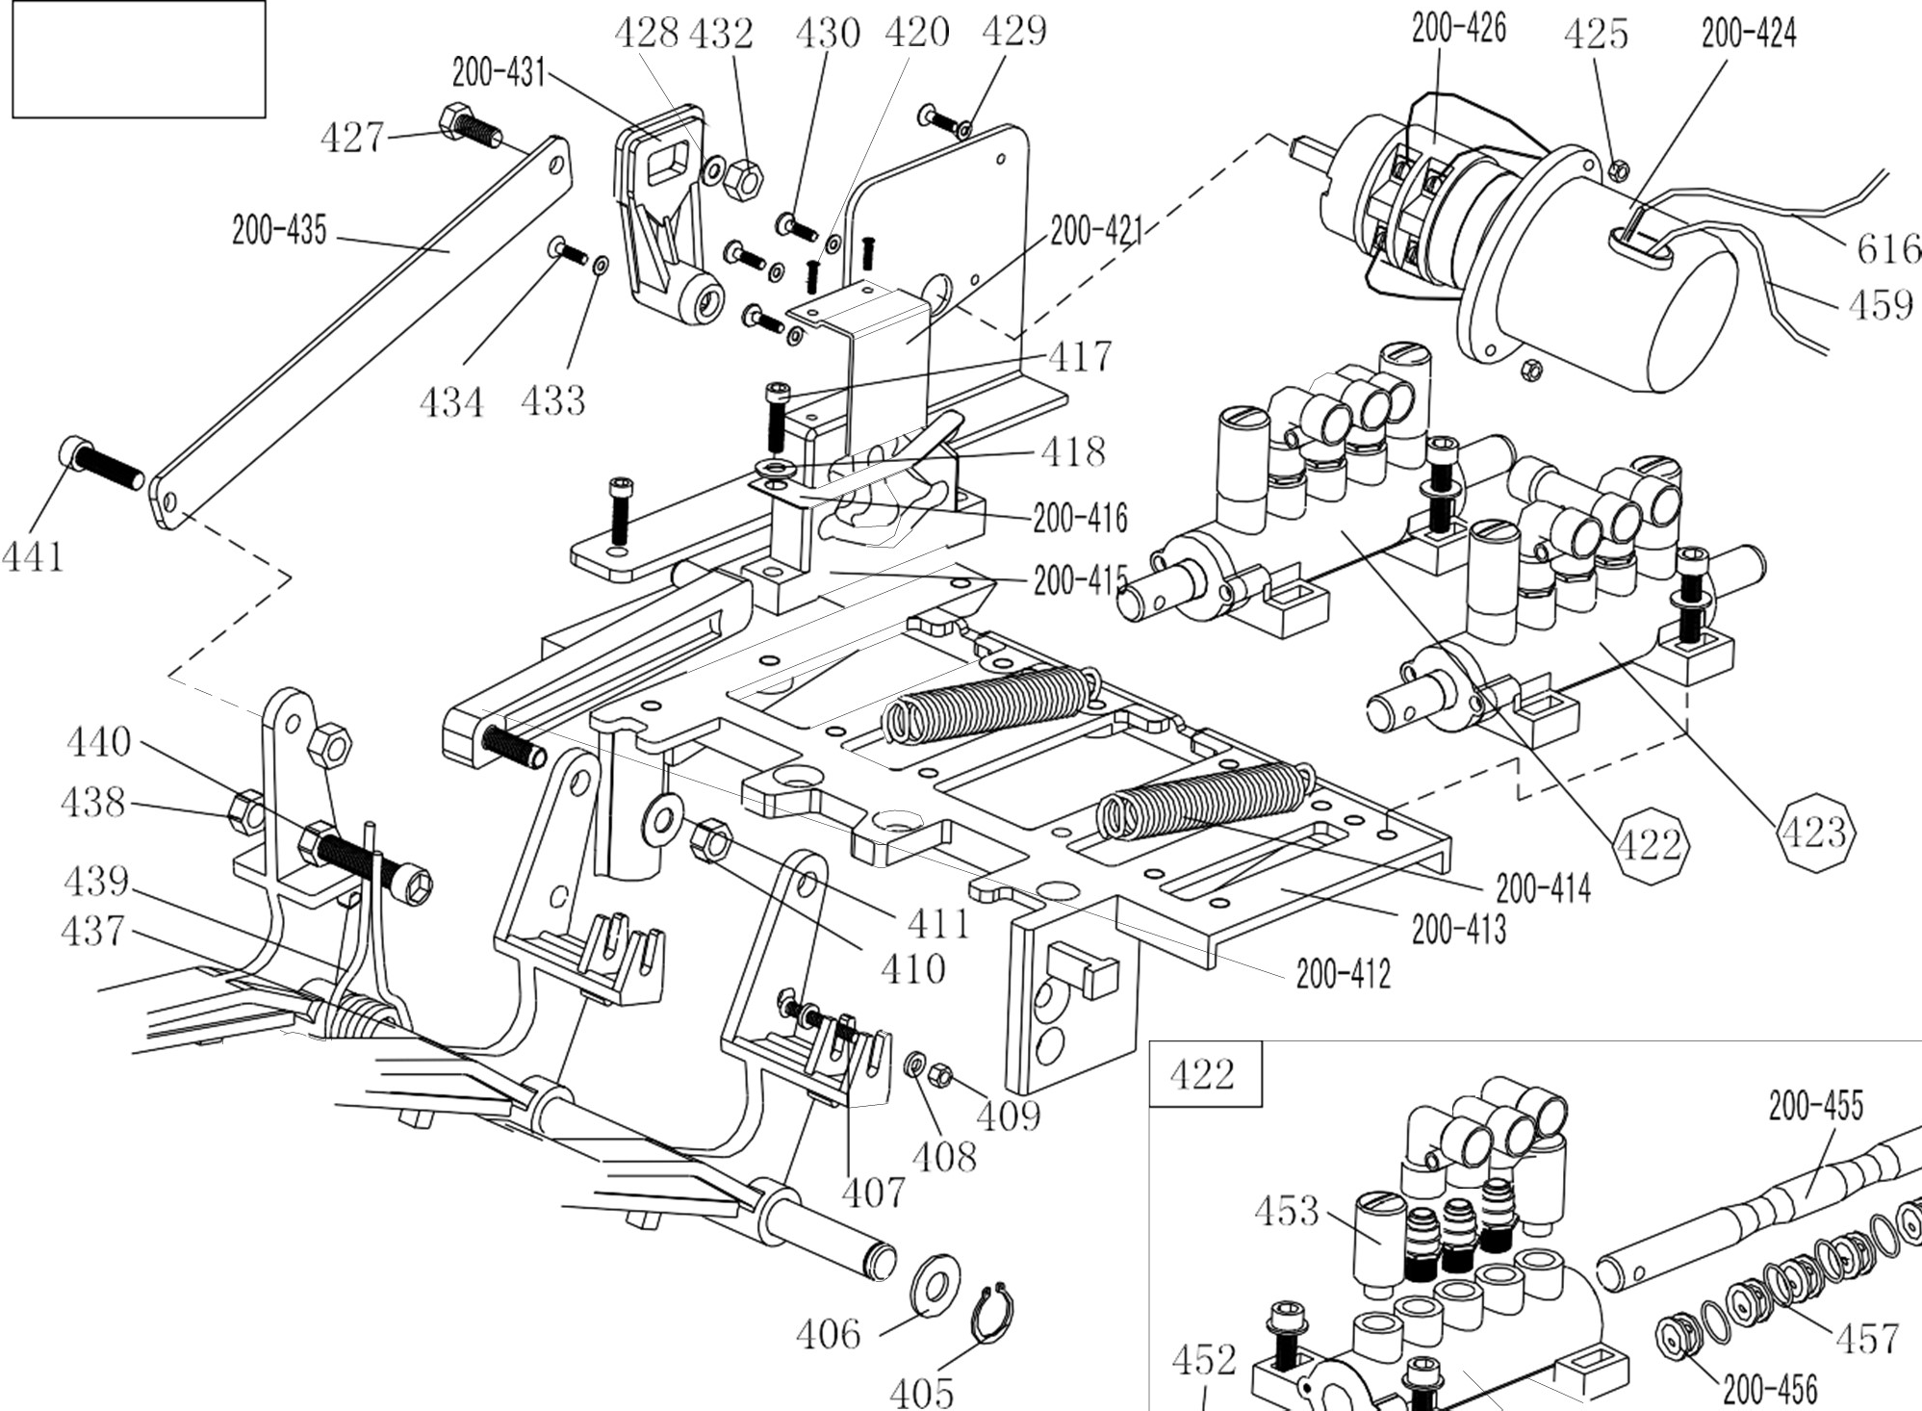




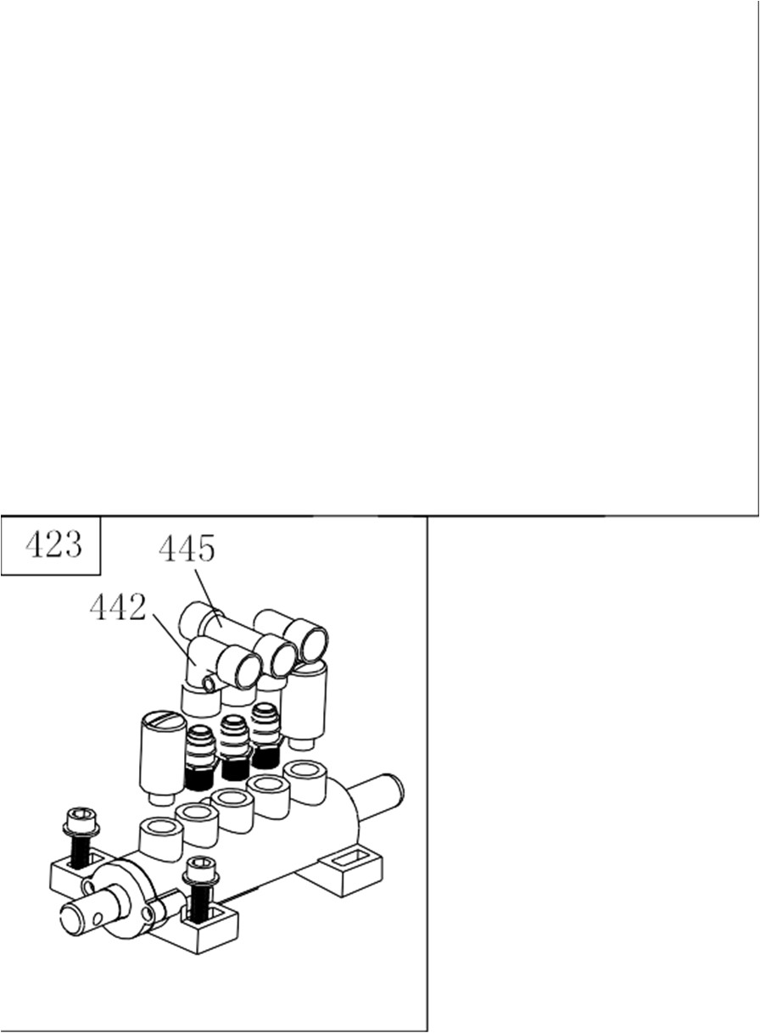
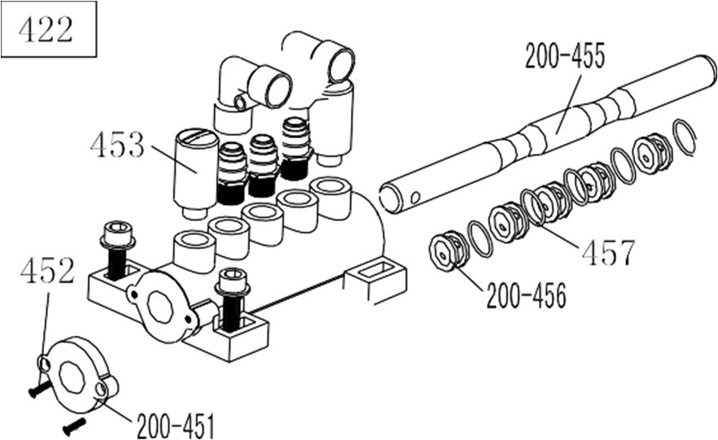


.1211 . V201301
200-480
- 14 -

Slide 16
.1211 . V201301
200-401 | C-200-060400-0 | Reverse switch pedal | 429 | B-040-040000-1 | Flat washer Ø 4
221-402 | C-221-060300-0 | 5-way valve pedal(right) | 430 | B-024-040161-0 | Cross-round head screw M4*16
405 | B-055-120001-0 | Snap ring Ø12 | 200-431 | C-200-530000-0 | Reverse switch handle
406 | B-040-122520-1 | Flat washer Ø12*24*2 | 432 | B-001-060001-0 | Self-locking nut M6
407 | B-024-040301-0 | Cross head screw M4X30 | 433 | B-040-030000-1 | Flat washer Ø3
408 | B-040-040000-1 | Flat washer Ø 4 | 434 | B-017-030161-0 | Cross head screw M3X18
409 | B-001-040001-0 | Self-locking nut M4 | 200-435 | CX-200-060600-0 | Pedal connection rod
410 | B-001-080001-0 | Self-locking nut M8 | 437 | CX-200-060700-0 | Pedal front shaft
411 | B-040-081715-1 | Flat washer Ø8*17*1.5 | 438 | B-004-080001-0 | Nut M8
200-412 | C-200-061300-0 | Cam connection rod | 439 | C-200-370000-0 | Pedal twist spring
200-413 | C-200-060100-0 | Pedal support board | 440 | B-010-080501-0 | Hex socket head bolt M8× 50
200-414 | C-200-380000-0 | Pedal Spring | 441 | B-010-080201-0 | Hex socket head bolt M8× 20
200-415 | C-200-061500-0 | Cam | 442 | S-012-010808-0 | Quick Union1/8- Ø 8
200-416 | C-200-810000-0 | Cam washer | 445 | S-016-010808-2 | Quick T-union1/8-2* Ø 8
417 | B-010-060201-0 | Hex socket head bolt M6×20 | 200-449 | C-200-060901-0 | 5-way valve barrel(left)
418 | B-040-061210-1 | Flat washer Ø6*12*1 | 200-451 | C-200-061100-0 | 5-way valve cover
420 | B-019-290121-0 | Cross head self tapping screw | 452 | B-024-290121-0 | cross head screw ST2.9*14
200-421 | CX-200-060500-0 | Cam cover | 453 | S-023-010801-0 | Muffler 1/8"
422 | CW-110-020000-0 | Complete 5-way valve for clamping cylinder | 200-455 | CX-200-061200-0 | 5-way valve rod
423 | CW-110-020001-0 | Complete 5-way valve for bead breaker cylinder | 200-456 | C-200-061000-0 | 5-way valve rod spacer
200-424 | C-200-061400-0 | Reverse switch cover | 457 | S-000-012400-0 | O-Seal 12*20*4
425 | B-004-040001-0 | Nut M4 | 459 | C2-000-103150-0 | Power supply cable
200-426 | S-060-016000-1 | Reverse switch | 616 | C2-000-205150-0 | Motor cable
427 | B-010-060201-0 | Hex socket head bolt M6×20 | 200-480 | CW-109-020000-0 | Complete 3-pedals assembly 200
428 | B-040-061210-1 | Flat washer Ø 6X12X1
- 15 –

Slide 17
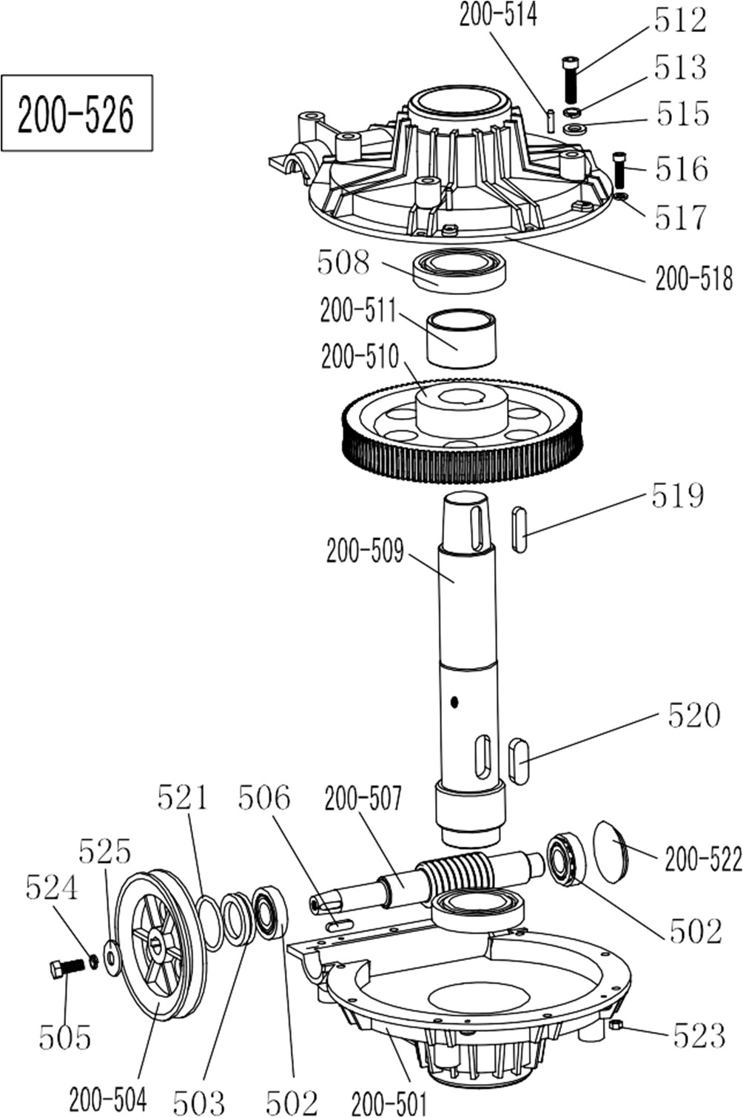
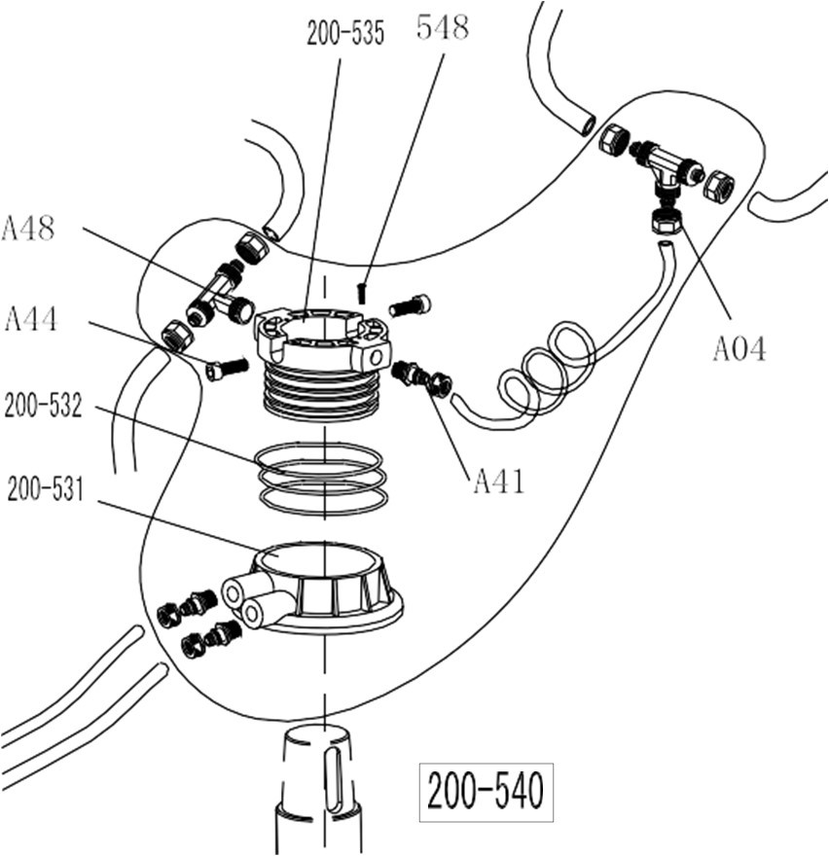
.1211 . V201301
200-501 | C-300-320302-0 | Gear box lower cover
502 | S-040-030204-0 | Bearing 30204
503 | S-005-020080-1 | Gear box seal φ20*35*8
200-504 | C-200-320500-0 | Gear Belt pulley
505 | B-014-080251-0 | Outer hex bolt M8×25
506 | B-065-006020-0 | Key washer 6×20
200-507 | C-200-320400-0 | Worm rod
508 | S-040-006010-0 | Bearing 6010
200-509 | C-200-320200-0 | Worm gear shaft
200-510 | C-200-320100-0 | Worm gear
200-511 | CZ-200-320600-0 | Worm gear shaft spacer
512 | B-014-100551-0 | Outer hex bolt M10×55
513 | B-050-100000-0 | Spring washer Ø10
200-514 | B-060-006020-0 | Pin 6X20
515 | B-040-102020-1 | Flat washer Ø10*20*2
516 | B-010-060201-0 | Hex socket head bolt M6×20
517 | B-040-061412-1 | Flat washer Ø 6*14*1.2
200-518 | C-300-320301-0 | Gear box upper cover
519 | B-065-010040-0 | Key washer 10×40
520 | B-065-014040-0 | Key washer14×40
521 | S-000-027310-0 | O-seal Ø 27.8*3.1
200-522 | C-200-320700-0 | Oil resistant seal
523 | B-001-060001-0 | Self-locking nut M6
524 | B-050-080000-0 | Spring washer Ø 8
525 | B-040-083030-1 | Flat washer Ø 8*30*3
200-526 | CW-107-020001-0 | Complete gear box
A04 | S-015-000008-3 | T-union 3* Ø 8
A44 | B-010-060161-0 | Hex socket head bolt M6×16
A48 | S-017-010808-2 | Quick T-union
200-531 | CZ-200-430100-0 | Rotating valve casing
200-532 | S-000-059262-0 | O-seal 59.9X2.62
200-535 | CZ-200-430200-0 | Rotating valve mandrel
537 | S-035-055080-0 | hose 5.5* Ø 8
A41 | S-011-010808-0 | Straight union1/8-Ø8
548 | B-007-040061-0 | Hex socket head bolt M4X6
200-540 | CW-016-020000-2 | Complete Rotating valve
- 16 -

Slide 18
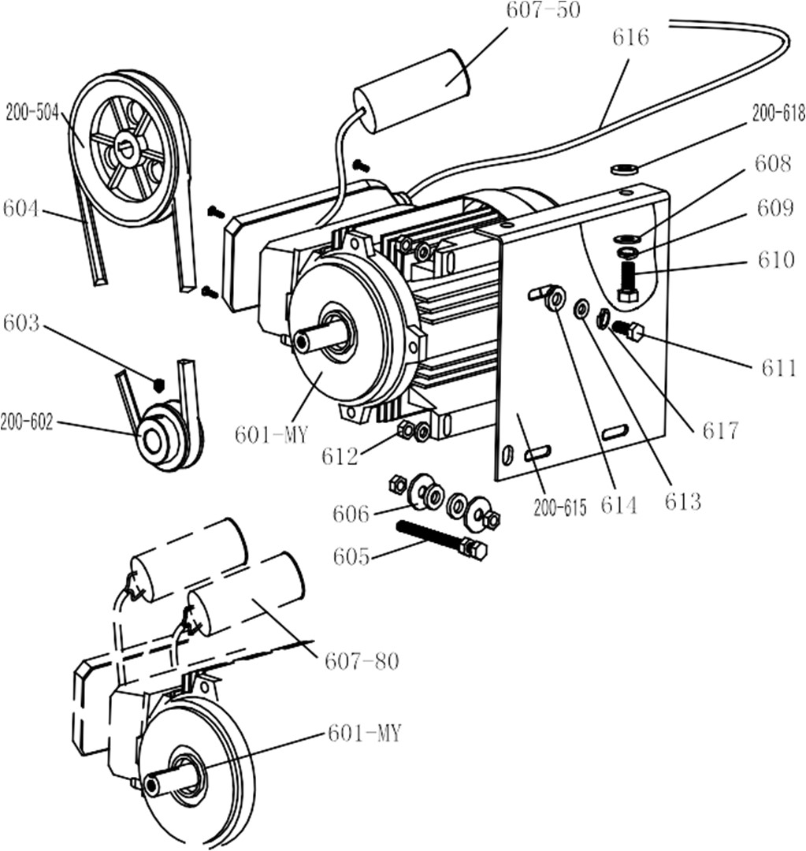
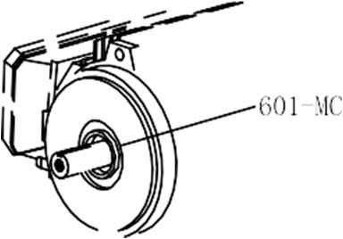
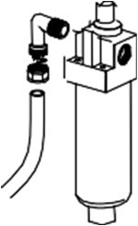
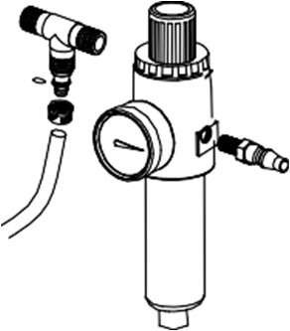

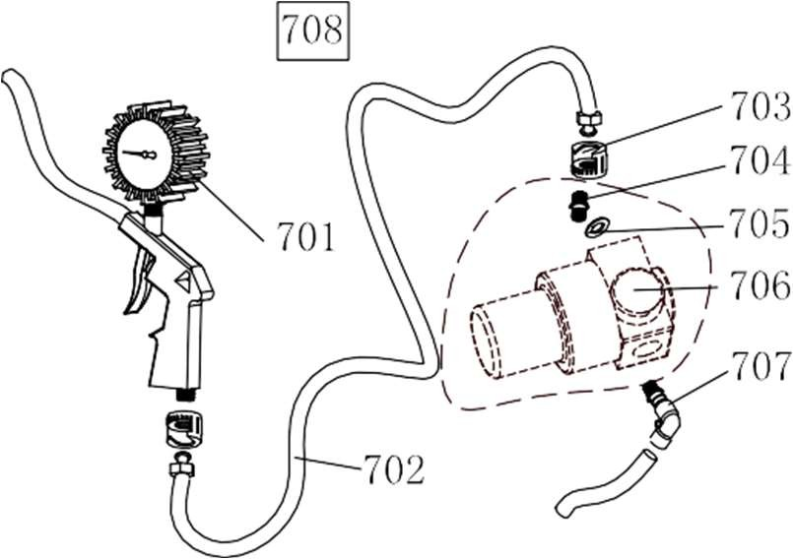
.1211 . V201301
200-504 | C-200-320500-0 | Gear Belt pulley
601-MC | S-050-220110-5 | Motor 220V/50HZ
601-MY | S-050-230075-0 | Motor 220v
200-602 | CX-200-330000-0 | Motor Belt pulley
603 | B-007-080121-0 | Hex socket head boltM8×12
604 | S-042-000686-0 | Tyre changer belt A-28
605 | B-014-080651-0 | Outer hex bolt M8X65
606 | B-040-083030-1 | Flat washer Ø8X30X3
607-80 | S-063-008000-0 | Capacitor 80μf,110V
607-50 | S-063-005000-0 | Capacitor 50μf,220V
608 | B-040-102020-1 | Flat washer Ø10X20X2
609 | B-050-100000-0 | Spring washer Ø10
610 | B-014-100251-0 | Outer hex bolt M10X25
611 | B-014-080351-0 | Outer hex bolt M8X35
612 | B-004-080001-0 | Nut M8
613 | B-040-082220-1 | Flat washer φ8X22X2
614 | C-200-560000-0 | Motor rubber washer
200-615 | CX-200-340000-2 | Motor support
616 | CZ-000-205150-0 | Motor cable 5×1.0
617 | B-050-080000-0 | Spring washer φ8
200-618 | C-200-560000-0 | Motor rubber buffer
810 | CW-114-020005-0 | Complete oil fog maker
701 | S-038-000100-0 | Inflating gun indicator
702 | S-035-014150-1 | Rubber connection hose
703 | S-025-104008-0 | Notch nut
704 | S-011-010414-1 | Straight union 1/4-1/4
705 | B-040-132420-1 | Flat washer Ø13
706 | S-030-010400-2 | Pressure adjust valve
707 | S-012-010408-0 | Quick Union 1/4-Ø8
708 | CW-090-000201-0 | Complete inflating gun
- 17 –

Slide 19



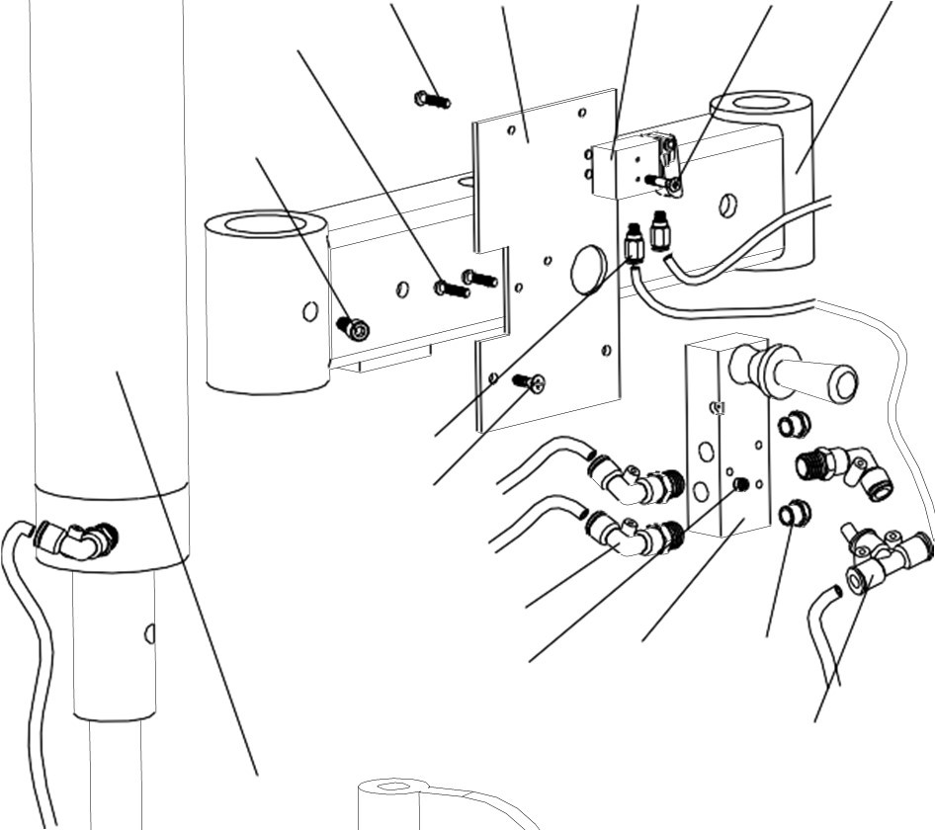






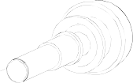







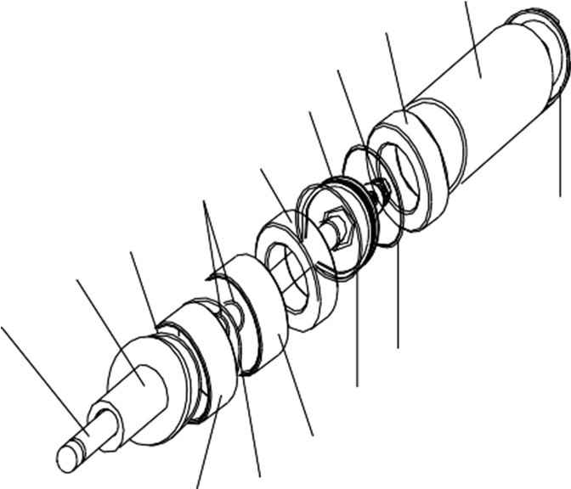
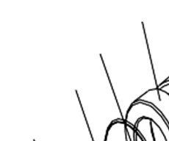

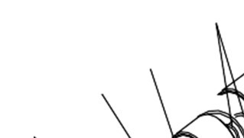


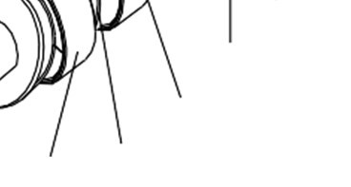

.1211 . V201301
F9823
F9801 | CX-098-020000-0 | Pressing arm(right)
F9802 | B-024-050101-1 | Cross head Screw M5X10
F9803 | S-030-010414-0 | Pneumatic valve
F9804 | CX-005-200000-0 | Raise-fall switch base plate
F9805 | B-017-040161-0 | Cross flat head screw M4*16
F9806 | B-017-040301-0 | Cross flat head screw M4*30
F9807 | B-007-100121-0 | Hex socket head bolt M10*12
F9809 | S-010-050004-0 | Straight union M5-Ø4
F9810 | B-010-050161-0 | Hex socket head bolt M5*16
F9813 | S-012-010406-0 | union 1/4-Ø6
F9814 | B-004-040001-1 | Nut ( silver ) M4
F9815 | S-030-010818-0 | Raise-fall control valve
F9816 | S-023-010801-6 | Muffler (brass)
F9817 | S-012-010406-0 | Quick L-union 1/4-φ6
F9818 | S-013-104206-0 | Quick T-union 2XØ6-Ø4
F9820 | S-017-010806-2 | T-union 1/8-2*Ø6
F9823 | C-007-181000-0 | Control valve protect cover
F9827 | CA-005-209800-2 | Complete 098 cylinder
F9828 | S-012-010406-0 | Quick Union 1/4-Ø6
F9829 | CX-098-040000-0 | Pressing roller bracket
F9830 | C-098-060100-0 | Tyre pressing roller 1
F9831 | B-055-300002-0 | Snap ring Ø30(hole)
F9832 | CX-098-050000-0 | Tyre pressing roller shaft
F9833 | C-098-060200-0 | Tyre pressing roller 2
F9805
F9804
F9803
F9802 F9801
F9806
F9807
F9809 F9810
F9813
F9814
F9815
F9816 F9818
F9827
F9829
F9830
F9831
F9832
F9833
F9827 | CW-105-209800-2 | Complete right help arm cylinder
F9827-1 | C-098-070400-2 | Help arm cylinder piston rod
F9827-2 | C-098-070100-0 | Help arm cylinder front cover
F9827-3 | B-055-400002-0 | Snap ring φ40
F9827-4 | S-000-030265-0 | O-seal φ30*2.65
F9827-5 | C-098-070600-0 | Right arm cylinder washer U098 Φ31*50*15
F9827-6 | C-098-075400-0 | Help arm cylinder piston φ70
F9827-7 | B-001-120001-0 | Self-locking nut M12
F9827-8 | CX-009-070300-0 | Help arm cylinder barrel
F9827-9 | C-098-070500-0 | Guide cover φ30*33*15
F9827-10 | S-000-063265-0 | O-seal φ63*2.65
F9827-11 | S-000-063355-0 | O-sealφ63*3.55
F9827-12 | U-006-000001-0 | Guide belt 4*2
F9827-13 | CX-098-070200-0 | Cylinder back cover
- 18 -

Slide 20
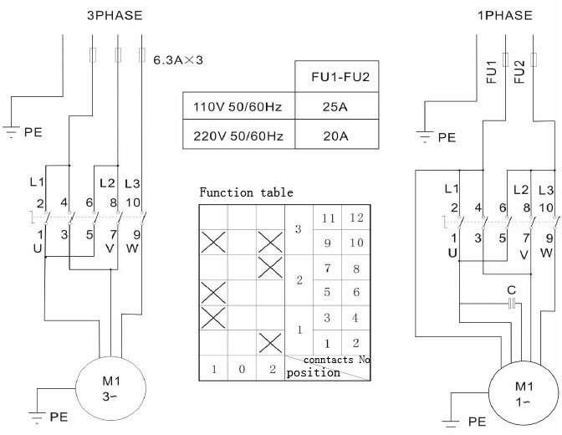
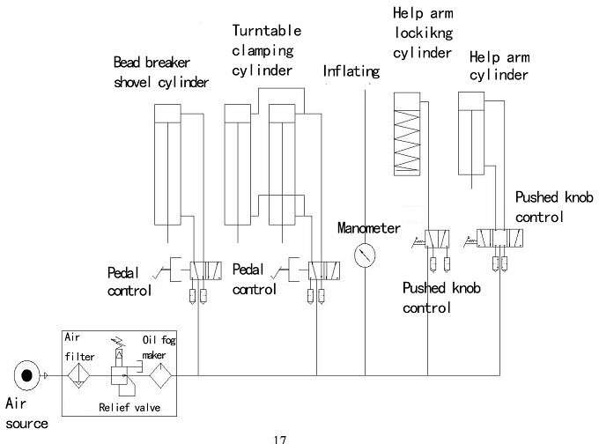
.1211 . V201301
16. Circuit diagram:
17. Pneumatic drawing:
- 19 –

